Slide 1
Live Session Unit 3
By Ben Goodwin

Slide 2
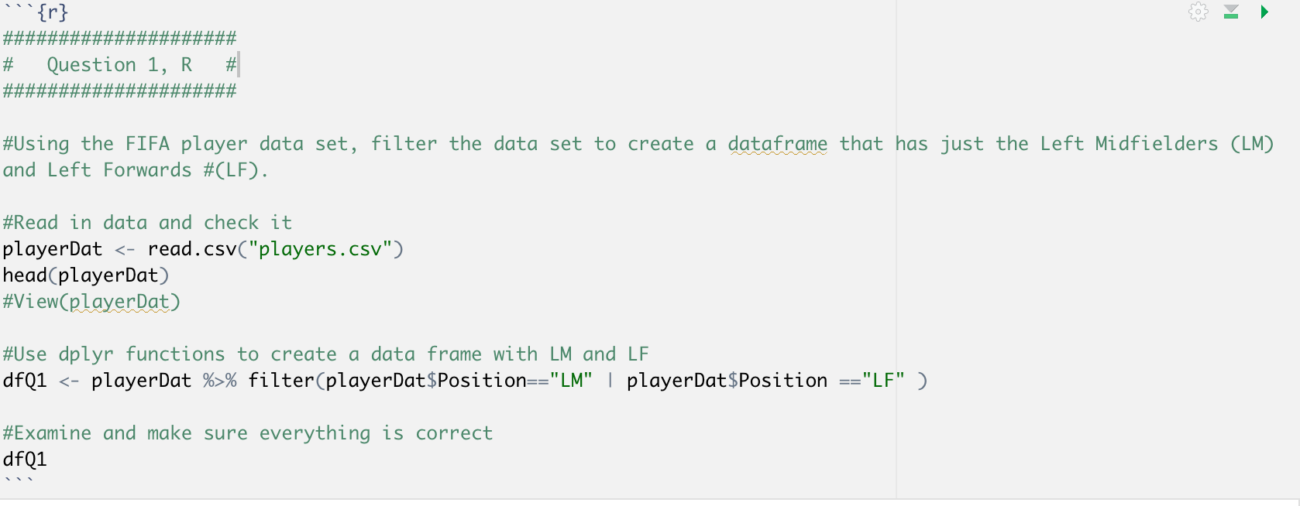
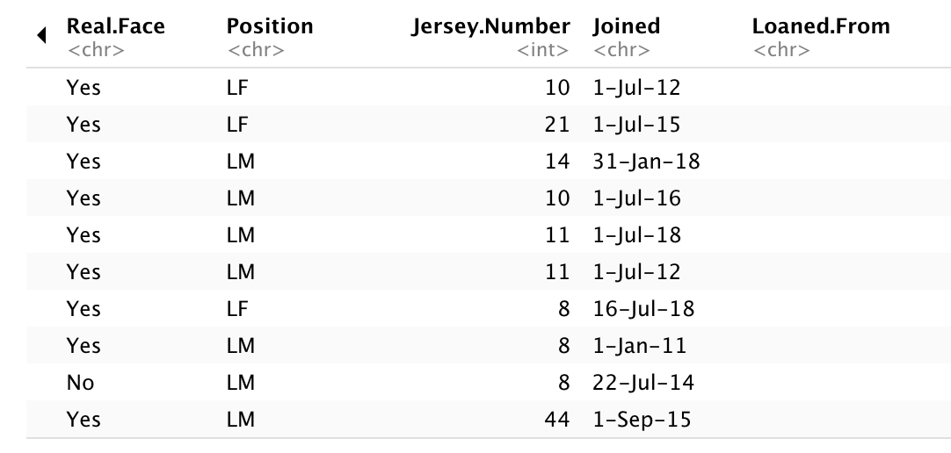
Live Session 3, Doing Data Science
Part 1
Example output:

Slide 3
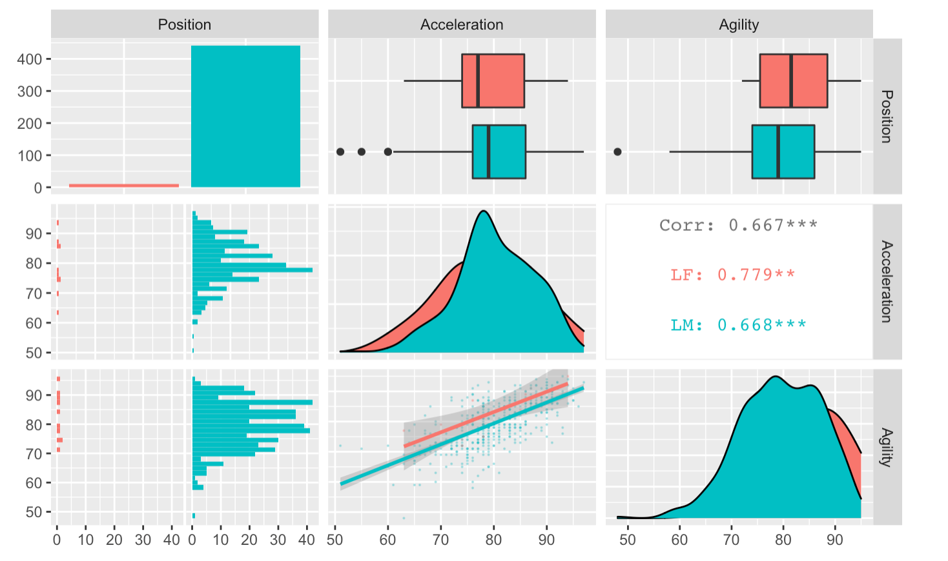
Live Session 3, Doing Data Science
Part 2, plot

Slide 4
Live Session 3, Doing Data Science
Part 3, takeaways
Left midfielders and left forwards appear to have similar characteristics
Left midfielders representer a larger percent of the population and impact the data as such
In certain variables left forwards seem to have an advantage such as in agility. While in acceleration they appear to have more spread
The data seems to tell that there left midfielders are a more homogenous population.

Slide 5
Live Session 3, Doing Data Science
Part 4, t-test
Step 1: H_0: Lf_agility = Lm_agility
H_a: Lf_agility != Lm_agility
Step 2: alpha=0.05
Step 3: Test Statistic: 1.1057
Step 4: P-value: 0.2964
Step 5: FTR H_0
Step 6: Based on the p-value of 0.2964, the statistical conclusion states we fail to reject the null hypothesis and determine there isn’t evidence for a difference between the mean agility levels between the two different player positions.

Slide 6
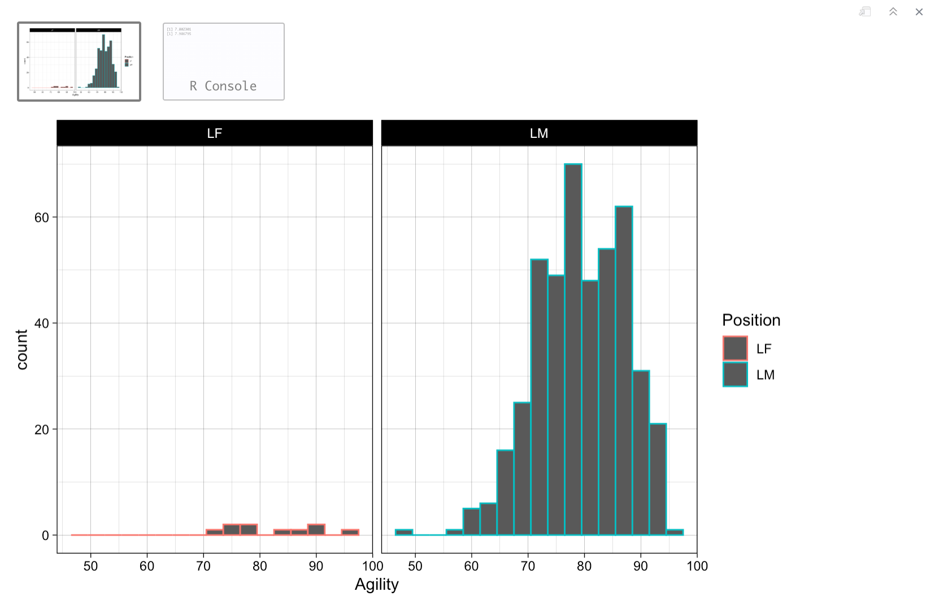
Live Session 3, Doing Data Science
Part 5, assumptions
Takeaways:
While the counts from left midfielders are much higher, the lack of the same information on left forwards should not indicate a significant deviation from model assumptions. I should also note that the t-test is robust against departures from normality. Based on background knowledge and this plot, I believe the t-test results are legitimate and do not violate model assumptions.

Slide 7
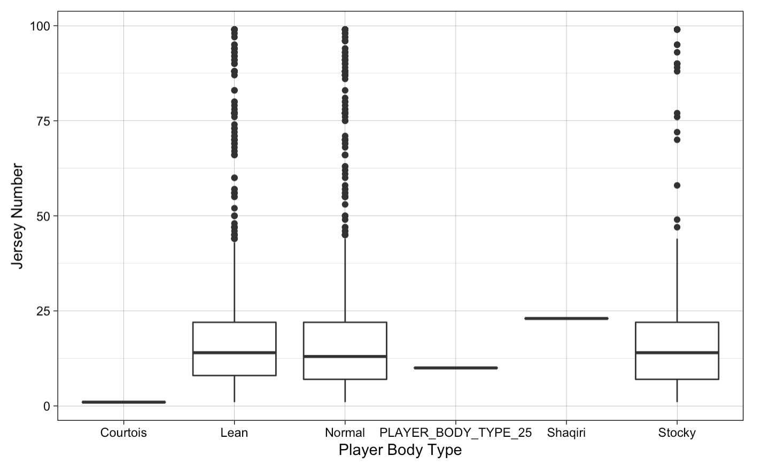
Live Session 3, Doing Data Science
Part 6, EDA

Slide 8
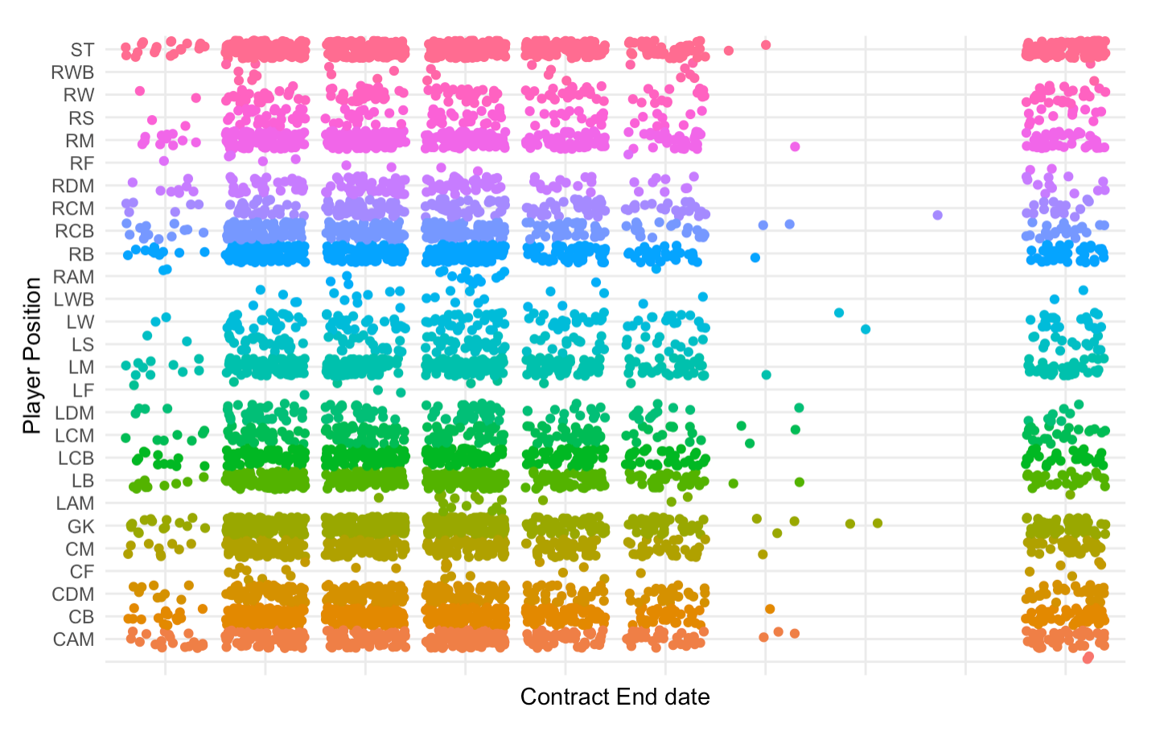
Live Session 3, Doing Data Science
Part 6, EDA 2

Slide 9
Live Session 3, Doing Data Science
Part 6, Takeaways
I’d like to learn a little more about some techniques for plotting categorical vs continuous variables.
Other than that, I felt pretty good about this week!

